Slide 1





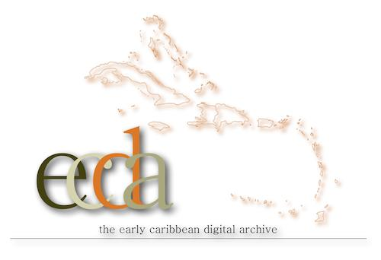
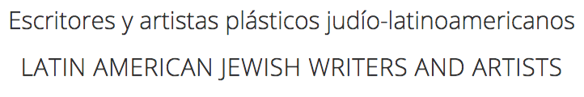

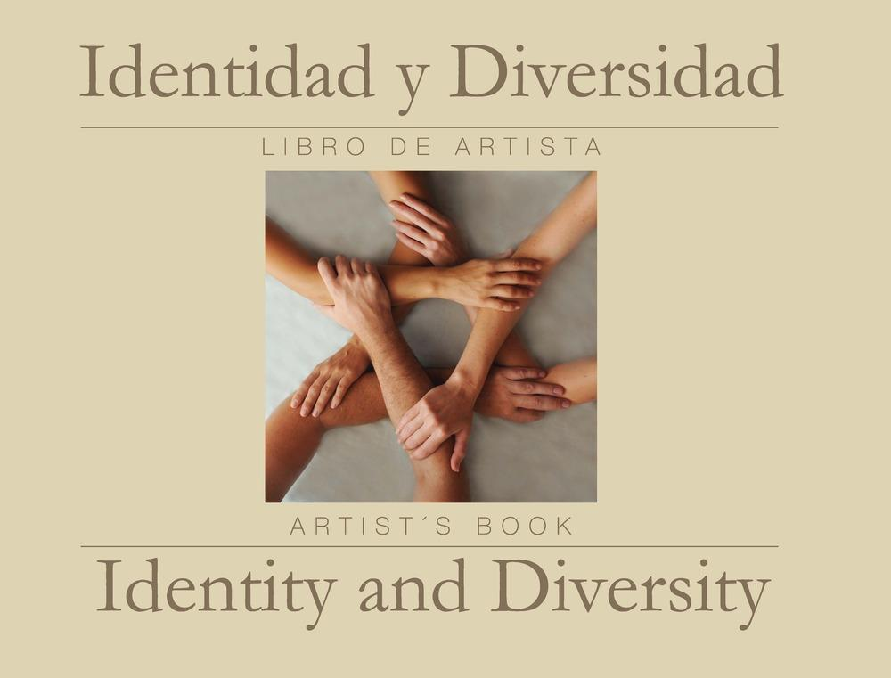



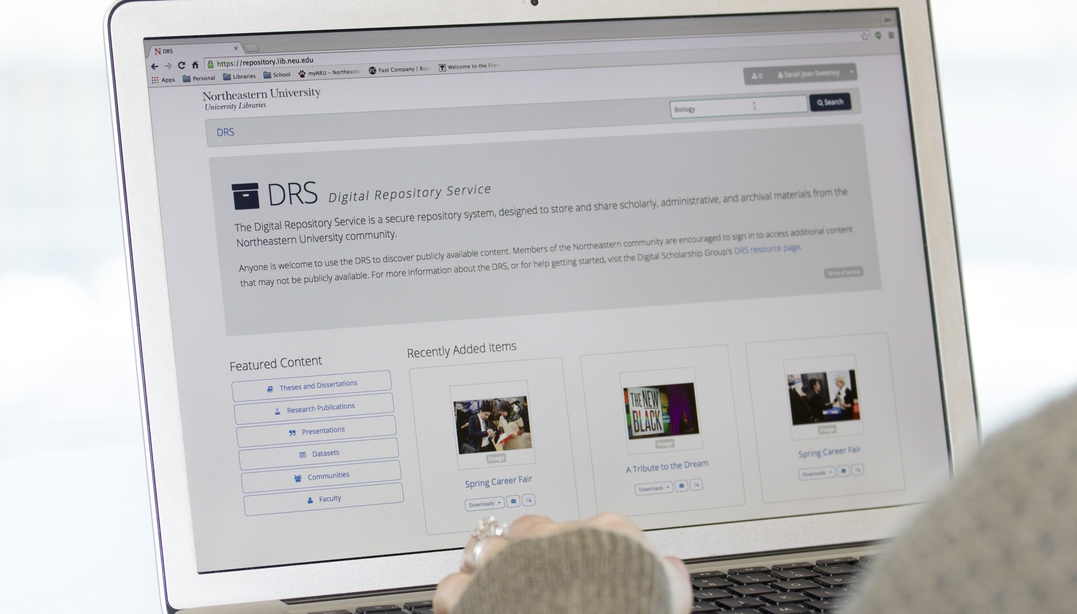
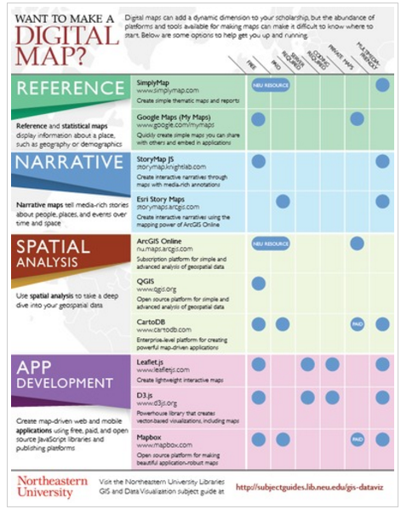

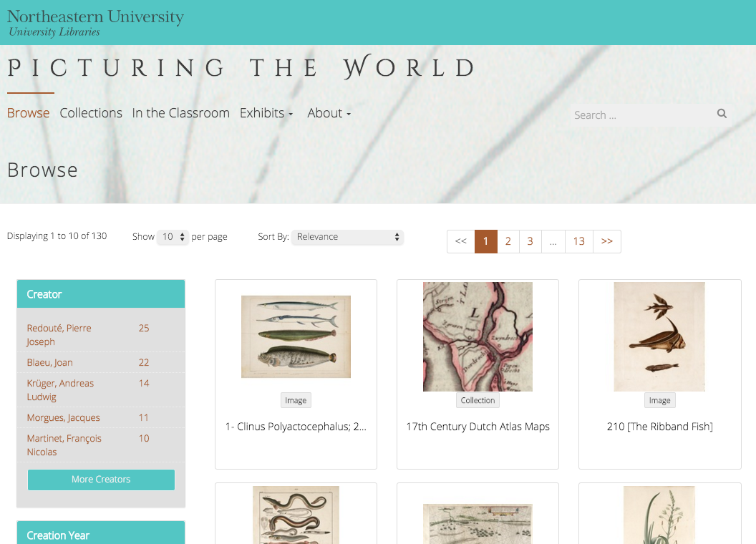
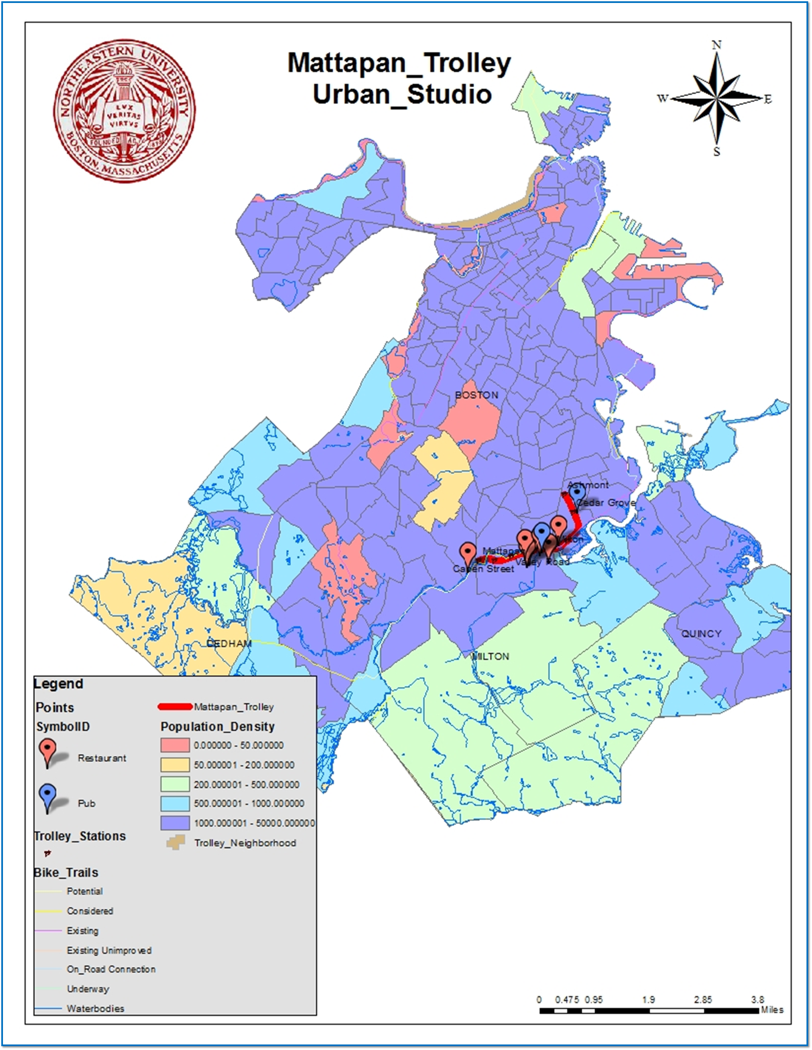
Digital Scholarship Group
dsg.northeastern.edu
What We Do
Our Projects and Partners
Digital Scholarship at Northeastern takes many forms! Working as an applied research team within the library, the Digital Scholarship Group (DSG) seeks out new digital scholarship tools and methods, tests them on real-world projects, and makes them available to the Northeastern community. We teach researchers at all levels new techniques of representation, analysis, and dissemination that are transforming scholarly research.
DSG projects are the groups and activities to which DSG provides direct tangible support. Projects might be organized around a publication, a research initiative, an event, or even an individual researcher’s work, and support can include server space, software installation, consultation, project work, partnering on grants, and more.
What all our projects have in common is that they use digital methods to answer questions in interesting and new ways, while engaging and questioning the effects of the digital medium on culture and communication.
Digital Repository Service: DRS
GIS & Data Visualization
Interested in Digital Scholarship?
repository.library.northeastern.edu
subjectguides.lib.neu.edu/gis-dataviz
dsg.northeastern.edu
The Digital Repository Service is a secure digital archive designed to store scholarly, administrative, and archival materials created or acquired by the Northeastern community.
The DRS stores more than 80,000 digital objects, most of which are available to the public.
The DSG provides educational materials for curricular and research needs to support scholarship that includes GIS or data visualization components.
Join us for an event! Upcoming events include:
GIS/Data Visualization Open Office Hours:
Every Thursday 2-3:30 in Snell CoLab D
Digital Humanities Open Office Hours:
Every Wednesday 1-2 PM in the DSC Media Lounge
We also offer customized workshops and consultations!
GIS and Data Visualization Services at DSG help you examine project datasets to reveal hidden patterns behind the datasets via mapping and visualization.
What types of material can you find in the DRS?
GIS and Data Visualization Services:
Consultation on all data collection, cleanup, management, and analysis processes
Guest class lectures
Customized, in-depth workshops
Research project work such as:
Data collection
Data cleanup
Web-based mapping
Spatial analysis
Custom mapping
Research and technical papers
Conference presentations
Theses and dissertations
Journals and books
Video and audio recordings
Digitized photographs and art prints
Past talks and workshops include:
XSLT Workshops
Feminist Data Visualization
Introduction to Omeka
Teaching Science Through Wikipedia
Design for Data Visualization Workshops
Open Tools for Mapping
Past DH Open Office Hours Guest Speakers:
Jim McGrath
Lauren Klein
Moya Bailey
and more…
The DRS Project Toolkit
DRS Project Toolkit was developed by the DSG to allow our projects to present digital project materials stored in the DRS in a customized website.
The Toolkit uses a custom WordPress template to make building beautiful websites easy, and storing the project files in the DRS guarantees they will be safe and secure.
Contact us: You can email us at DSG@neu.edu or find us online at dsg.neu.edu
Visit our offices:
The DSG offices are located on the second floor of Snell Library in the Digital Scholarship Commons. Turn right when exiting the main stairwell and continue to the double glass doors to the Digital Scholarship Commons. DSG offices (room 213) will be straight ahead.
Not sure if you need to contact us? Students reach out for below projects recently:
Discovering how airport noise pollution affects Boston
Finding actual distance between ports of USA
Analysing music industry data and visualize the Billboard data

